Slide 1


Day 1
16:20 PM – 17:00 PM
BUSINESS
UNDERSTANDING
Organized and Conducted by
Data For Excellence
(DFE)

Slide 2



MAJOR ACTIVITIES IN PORT OPERATIONS
Arrival at Anchorage
1st Pilot Boarding
– [Pilot On Board Time]
3
2
1
Request for Pilot
Waiting at anchorage
Arrival at Port Water
1
2
2nd Pilot Boarding
– [Pilot On Board Time]
3
Arrival at Berth
- [ATB]
4
Operations Start
- [First Activity Time]
5
Operations End
- [Last Activity Time]
6
Departure
- [ATU]
7
Pilot Disembarkation
– [Pilot Job End Time]

Slide 3
KEY PLANNING & OPERATIONS PROCESSES
Complexity and
considerations
Vessel Operations
Planning/control
Vessel en route to PSA
BOA, Container Yard Location, ITT/IGT
Berth planning
Yard planning
Yard clash, Yard Crane deployment
Stowage planning
Resource planning
QC deployment, Crane split, Vessel stability, Tight Connections
Vessel ATB
Operations Control
+
Resource Mgt
+
Plan Adjustments
Labour required
Crane Operators, WOS, PM Drivers, Lashing
Vessel 1st Move
Vessel Last Move
Asset & Resource productivity,
Vessel performance
Vessel ATU

Slide 4



KEY TERMINOLOGIES
Transshipment
7. Import
8. Export
5. Port of Loading or Previous Port
6. Port of Discharge or Next Port
3. Discharging Route/Service
4. Loading Route/Service
Discharging & Loading Operations
1. Discharging Vessel
2. Loading Vessel
Current
Terminal
Legend:
Odd numbers : Discharging Operation
Even numbers : Loading Operation

Slide 5
CARGO FLOW ANALYTICS PROJECT
THE PROBLEM STATEMENT
Clean, transform and prepare a raw port dataset into usable and clean data for further analysis
Derive useful insights from the container loading / unloading event data collected from a port terminal
Augment existing port dataset with external data to add value to existing insights
Create powerful and relevant visualization from the clean dataset with interactive features for the end-users

Slide 6
INCOME LEVEL PREDICTION PROJECT
THE PROBLEM STATEMENT
Predict the income level of a person based on the publicly available individual attributes data about the person.
The output is Yes/No or (1/0), where Yes or 1 indicate that the person will earn more than 50k

Slide 7
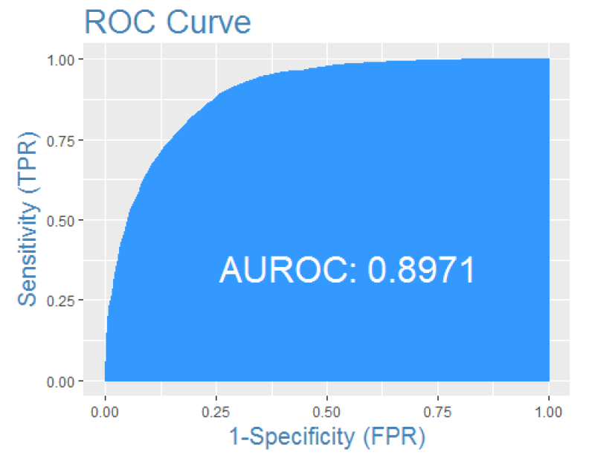
ROC CURVE

Slide 8
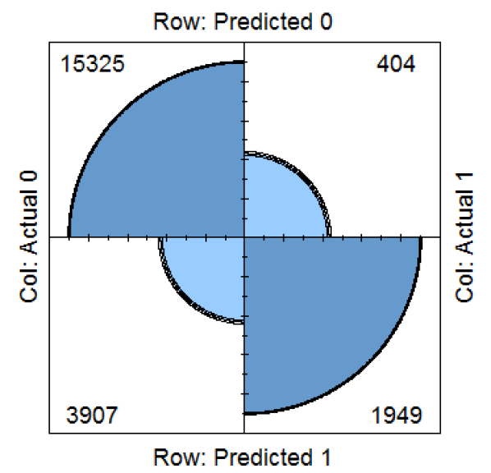
CONFUSION MATRIX

Slide 9
PORT THROUGHPUT PROJECT
THE PROBLEM STATEMENT
Predict the next year global port throughput volume in TEU
Estimate the upper and lower range of TEU with 95% confidence

Slide 10
Combined Model Results
TEU in Millions | PSA Forecast
Period | TEU | Growth YoY
2019 Q1 | 198.5 | 3.7%
2019 Q2 | 203.9 | 4.2%
2019 Q3 | 204.7 | 4.3%
2019 Q4 | 203.3 | 4.0%
2019 Full Year | 817.6 | 5.0%
Note 1: Quarterly figures may not add to full year figures because multiple models are used to forecast yearly numbers.
Note 2: All models are based on TEU counting method as practiced by Drewry.
Note 3: Multiple sources are used to get historical and forecast data related to World GDP, CPI, Global Oil Price, Air Traffic Logistics, BDI, PMI, Global Stock Index and World Export.

Slide 11
Quarterly Trend & Forecast
TEU in Millions
YoY Growth %
Note 1: Quarterly figures may not add to full year figures because multiple models are used to forecast yearly numbers.
Note 2: All models are based on TEU counting method as practiced by Drewry.
Note 3: Multiple sources are used to get historical and forecast data related to World GDP, CPI, Global Oil Price, Air Traffic Logistics, BDI, PMI, Global Stock Index and World Export.

Slide 12
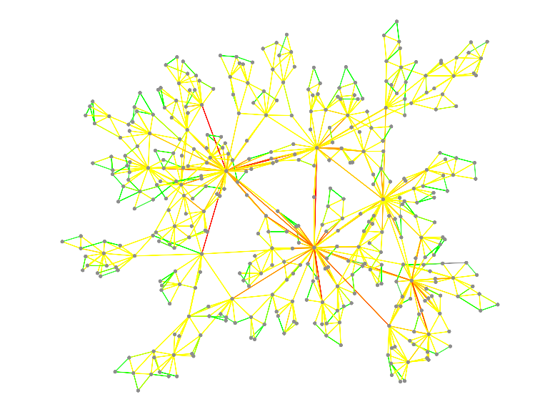

The End

